Slide 1
ASSESSING

Slide 2

OBJECTIVES
Notes:
At the end of this session participants will:
Understand the purpose of assessment in BLS
Understand different approaches to assessment
Understand some factors that can influence an assessment
Understand the limitations of assessment processes
Gain practical experience in continuous assessment
‹#›

Slide 3

WHAT IS
ASSESSMENT?
Notes:
“Evaluate or estimate the nature, value, or quality of…”
‹#›

Slide 4

WHY DO ASSESSMENT?
Notes:
Establish level of skill attainment
Competence
Certification
Motivation for learning
‹#›

Slide 5

WHO NEEDS TO BE ABLE TO ASSESS?
Notes:
Teachers
Examiners
‹#›

Slide 6

SPECIFICITY
Notes:
Specificity: Assessment of a defined feature
‹#›

Slide 7
VALIDITY
Notes:
Validity: It tests what it says it tests
‹#›

Slide 8
RELIABILITY
Notes:
Reliability: Different assessors would get the same result
‹#›

Slide 9
FEASIBILITY
Notes:
Feasibility: It can be done
‹#›

Slide 10
FIDELITY
Notes:
Fidelity: Is it like real life
‹#›

Slide 11

METHODS OF ASSESSMENT
Notes:
Theoretical
MCQ
Short answers
Essay
Clinical cases
Practical
Continuous
Summative
Types of practical
Skills test
Scenario tests
Workplace
‹#›

Slide 12
RMD ASSESSMENT
Monday night sessions
  Continuous assessment
  Skills test
  Scenario test
End of course exam
  Certification
Notes:
‹#›

Slide 13
BLS CONTINUOUS ASSESSMENT
Scenario test
Observe during teaching
Candidates need to demonstrate skills during session
Competence
Notes:
‹#›

Slide 14
BLS CONTINUOUS ASSESSMENT
Specificity ✓
Validity ✓
Reliability ✓ ✗
Feasibility ✓
Fidelity ✓ ✗
Notes:
Specificity: Assessment of a defined feature
Validity: It tests what it says it tests
Reliability: Different assessors would get the same result
Feasibility: It can be done
Fidelity: Is it like real life
‹#›

Slide 15
DURING AN ASSESSMENT

Slide 16
Exam form
Notes:
NEED UPDATED VERSION OF THIS
Global assessment
First decision is final from examiners

Slide 17
AFTERWARDS

Slide 18
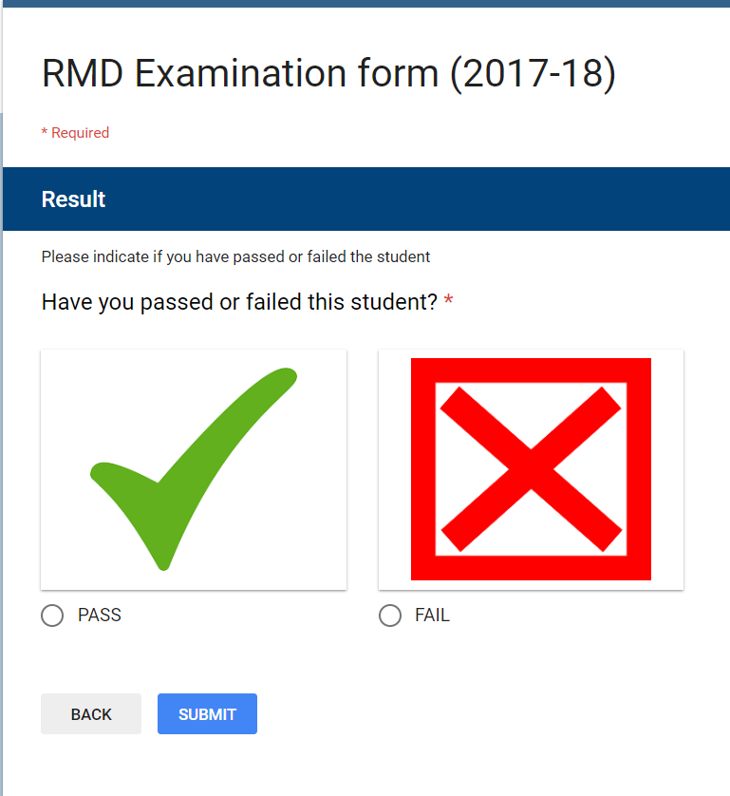

Slide 19

THE RESULT
Notes:
Confirm your final decision in your mind
Let the candidate know promptly
Congratulate them
(Learning conversation)
‹#›

Slide 20
ANY QUESTIONS?

Slide 21

SUMMARY
Notes:
Assessment is for teachers and assessors
Judgment of whether expected standard has been reached
Requires
Preparation
Observation
Decision
Communication

