Slide 1
THE LEARNING CONVERSATION

Slide 2
OBJECTIVES
To learn how to give great feedback
  Understand what is meant by a learning conversation
  Identify how to use it
  Embed learning conversation as core method of feedback

Slide 3

Notes:
Show of hands - who’s heard of the learning conversation?
Or any other ways of giving feedback?

Slide 4

Learning conversation
Notes:
Feedback is an essential component of the basic life support course
It enables your students to reflect on their performance and identify areas for improvement
The format we would like you to use when feeding back to your student is called the learning conversation.

Slide 5

Components of the learning conversation
Clinical governance meeting
Scheduled: 6 Oct 2023 at 12:30 pm to 1:30 pm, BST
Opening gambit
Exploring issues
Group contributions
Sharing your thoughts
Final comments & qns
Summary
1
2
3
4
5
6
Notes:
The opening gambit
Instructor initiates a conversation – can break the ice by beginning with a compliment
2. Exploring issues with candidate
Often their most pressing issue is the first to be discussed
‘I forgot to look up when I pressed shock’
Candidate often explains what they do know ‘but obviously was aware to make sure the pads go on the right way around’
And then goes on to identify what they did and didn’t know
3. Group contributions
Feedback what they thought
Instructor builds upon group comments to make a point
Ask stimulating questions to whole group
Identify points for improvement for candidate through the group comments
Ask group if they know the answer to questions the candidate doesn’t know
4. Sharing your thoughts
Advocacy with enquiry
‘what was going through your mind?’
asks candidate to reflect on what they’d thought
‘when you said you were going to check for circulation, what did you actually check for?’
candidate explains what they did – instructor can correct at this point
5. Final comments - ask for questions
Check there is nothing requiring attention
‘was there anything else that someone would like to ask about?’
6. Summary
Draw the session to a close
Identify the main summary points – good points for a positive ending, and how to make yourself perform slightly better the next time

Slide 6

Key elements
candidate - group - self

Slide 7

Maximise candidate & group thinking time
Notes:
A common error is to present your own ideas first before the candidate & group have explored ideas
If they have covered all points well, one does not need to reiterate them all again...

Slide 8
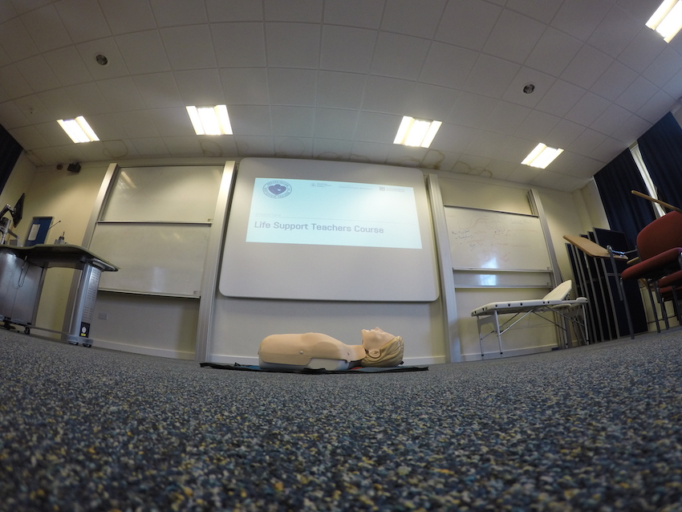
Teaching CPR + AED

Slide 9

Teaching all skills
Notes:
This is a good technique for many areas where one acts as an instructor

Slide 10
ANY QUESTIONS?

Slide 11
SUMMARY
‘There are no secrets in teaching resuscitation effectively’
Effective feedback promotes learning
Learning conversation useful when training skills
  Candidate thoughts > Group thoughts > Instructor thoughts
  Final comments & questions > Summary > Closure

Slide 12

A POSITIVE EXPERIENCE LEADS TO EFFICIENT LEARNING

