Slide 1
TEACHING ADULTS
Notes:
Principles of adult learning and teaching
Consider how we best learn
So we can adjust our teaching techniques
To optimise the learning experience

Slide 2
OBJECTIVES
Understand what is meant by learning and teaching
Identify requirements for successful adult learning
Understand the structure of a training sequence

Slide 3

What is learning?
Notes:
Ask your candidates “what is learning”
Elicit response in a positive way.
You will probably end up with different opinions
Tell the candidates we define «learning» as a relatively permanent and important changing in behaviour as a result of an experience
Emphasize on the importance of the part «learning experience»
Conclude that there are a number of positive and negative learning experiences; they touch all aspects of learning
…a relatively permanent change in:
Knowledge
Behaviour
As a result of:
A confrontation with other knowledge
An experience

Slide 4

How do adults learn?
Notes:
Enumerate the different ways adults learn by using the list of experiences they’ve given
Showing the picture, ask them: can an adult learn in every environment? What is the best way to learn?
Listening
Trying
Searching
Imitating
Confronting
Observing

Slide 5

Requirements for successful adult learning?
Notes:
- Let the candidates list a number of requirements. Write the key words on the whiteboard & facilitate this list
Motivation
The subject is relevant
Objectives are set
The subject is within the learner's capacity to learn
The subject is within the teacher’s experience
Roles are identified
Active participation by learners
Episode is planned
Feedback - good quality
Opportunities for reflection

Slide 6

What is teaching?
Notes:
Ask your candidates “what is teaching?”
Elicit response in a positive way.
You will probably end up with different opinions
Tell the candidates we define teaching as the way in which we allow people most effectively to learn. («learning» is a relatively permanent and important changing in behaviour as a result of an experience).
Emphasize on the importance of the part «learning experience»
Conclude that there are a number of positive and negative learning experiences; they touch all aspects of learning
…a relatively permanent change in:
Knowledge
Behaviour
As a result of:
A confrontation with other knowledge
An experience

Slide 7
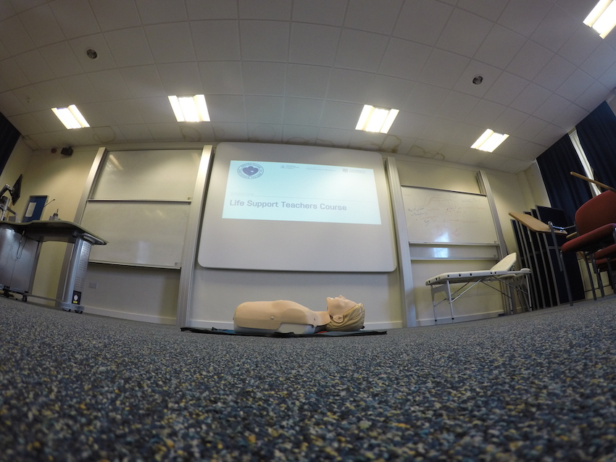
Teaching CPR + AED
Notes:
- During BLS and AED provider courses, we use a number of specific techniques.
List the techniques and explain that the instructor course is build around these techniques
Uses a number of techniques:
Lectures
Skill stations
Workshops/discussion groups
Scenarios

Slide 8
Lectures
Notes:
- During BLS and AED provider courses, we use a number of specific techniques.
List the techniques and explain that the instructor course is build around these techniques
Awaken old knowledge
Provide information about new knowledge

Slide 9
Skill Stations
Notes:
Show them in real time → Awareness/priming
Show them again but slower and explain → Connecting new information to old knowledge
Let them tell you how (and why) to show → Transferring the newly constructed knowledge
Let them do it themselves → Validating the newly constructed knowledge

Slide 10
Discussion Groups
Notes:
Practicing CPR with tutorial feedback
Discussing a legal and/or ethical issue (such as altered CPR because of COVID-19)

Slide 11
Scenarios
Notes:
- During BLS and AED provider courses, we use a number of specific techniques.
List the techniques and explain that the instructor course is build around these techniques
Practicing in a simulated situation
No interruptions during practicing
Constructive feedback afterwards

Slide 12

Key elements
Prepare
Open
Facilitate
Close
Notes:
Refer to the discussion group where many aspects of a teaching session were discussed.
Put emphasis on the universal elements of a teaching session: environment, set, dialogue and closure.

Slide 13
PREPARE
Notes:
The instructor, having prepared the session content, room layout, and environment beforehand, also ensures all equipment is working, briefs any co-instructor on their role, and remains constantly aware of the time.

Slide 14
OPEN
Notes:
The instructor introduces all participants (self, co-instructor, and candidates), then outlines the session's flow, and clearly states the learning and assessment outcomes.

Slide 15
FACILITATE
Notes:
The instructor first explains and demonstrates the skill, then facilitates candidate practice while acknowledging prior experience, assesses whether learning outcomes are met, provides or organises additional coaching as needed, and, as necessary, interacts with the co-instructor to confirm assessment decisions.

Slide 16
DELIVERY OF SKILLS TEACHING
Teach it Teach the concept and the course standard
Facilitate it Get all candidates involved in trying the skill
Assess it Confirm the course standard has been reached (this might be possible within the facilitation stage)
Encourage peer-to-peer learning. This may be less of a feature within our course than in postgraduate courses where, for example, experienced emergency care staff can add significantly to the learning of others, including the instructors – I learn when I teach.
Notes:
Skills teaching is a special situation where new skills need to be transferred from the instructor to the candidate

Slide 17
DELIVERY OF SKILLS TEACHING
Teach it Teach the concept and the course standard
Facilitate it Get all candidates involved in trying the skill
Assess it Confirm the course standard has been reached
Encourage peer-to-peer learning

Slide 18

FEEDBACK
Notes:
- Tell the candidates that feedback has to be given in a positive way and must be constructive in order to stimulate the candidate’s skills learning
Give an example
Learning Conversation
Who gives feedback?
Candidate, then
Peers, then
Instructor
Feedback should note points for improvement

Slide 19
Learning conversation
Notes:
Learning conversation guide
Feedback is an essential component of the basic life support course; it enables your students to reflect on their performance and identify areas for improvement. The format we would like you to use when feeding back to your student is called the learning conversation. Below is a guide of the structure:
The opening gambit
Exploring issues
Group contributions
Sharing your thoughts
Final comments
Summary
The opening gambit
Instructor initiates a conversation – can break the ice by beginning with a compliment
2. Exploring issues
Often the most pressing issue is the first to be discussed – ‘I forgot to look up when I pressed shock’
Candidate often explains what they do know ‘but obviously was aware to make sure the pads go on the right way around’
And then goes on to identify what they did and didn’t know
3. Group contributions
Feedback what they thought
Instructor builds upon group comments to make a point
Ask stimulating questions to whole group
Identify points for improvement for candidate through the group comments
Ask group if they know the answer to questions the candidate doesn’t know
4. Sharing your thoughts
Advocacy with enquiry
‘what was going through your mind?’
asks candidate to reflect on what they’d thought
‘when you said you were going to check for circulation, what did you actually check for?’
candidate explains what they did – instructor can correct at this point
5. Final comments
Check there is nothing requiring attention
‘was there anything else that someone would like to ask about?’
6. Summary
Draw the session to a close
Identify the main summary points – good points for a positive ending, and how to make yourself perform slightly better the next time

Slide 20
CLOSURE
Notes:
The instructor gains feedback from candidates, summarises key learning points, informs candidates of their successful or unsuccessful outcome, completes all necessary documentation, outlines next steps or future sessions, thanks the co-instructor and candidates, and ensures the area is left tidy.

Slide 21
ANY QUESTIONS?

Slide 22
SUMMARY
‘There are no secrets in teaching resuscitation effectively’
Preparation and planning of a positive experience
Prepare - Open - Facilitate - Close
Staged approach: Teach it - Facilitate it - Assess it
Questions, summary, closure

Slide 23

A POSITIVE EXPERIENCE LEADS TO EFFICIENT LEARNING

