Slide 1
CPR Modifications & First Aid
Notes:
initial heart-rhythm analysis, about 25–50% of SCA victims have ventricular fibrillation (VF), a percentage that has declined over the last 20 years.7–13 Itis likely that many more victims have VF or rapid ventricular tachycardia (VT) at the time of collapse, but by the time the first electrocardiogram (ECG) is recorded by emergency medical service personnel their rhythm has deteriorated to asystole.14,15 When the rhythm is recorded soon after collapse, in particular by an on-site AED,the proportion of victims in VF can be as high as 76%.16,17 More victims of SCA survive if bystanders act immediately while VF is still present. Successful resuscitation is less likely once the rhythm has deteriorated to asystole.

Slide 2
OBJECTIVES
Understand how to manage a more extended range of patients and situations
    Unconscious
    Infection risk
    Children
    Drowning
    Choking
    Bleeding

Slide 3
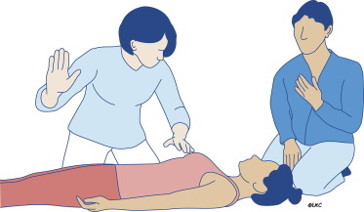
UNCONSCIOUSNESS
Assess the collapsed or unwell person
They respond
  Leave in the same position
  Find out what is wrong
  Reassess regularly

Slide 4
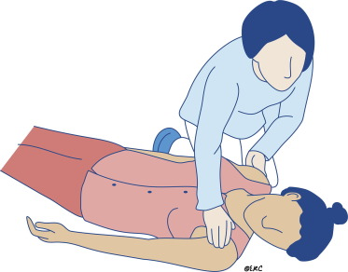
UNCONSCIOUSNESS
Assess the collapsed or unwell person
They do not respond but breathing normally
  Put them in recovery position

Slide 5
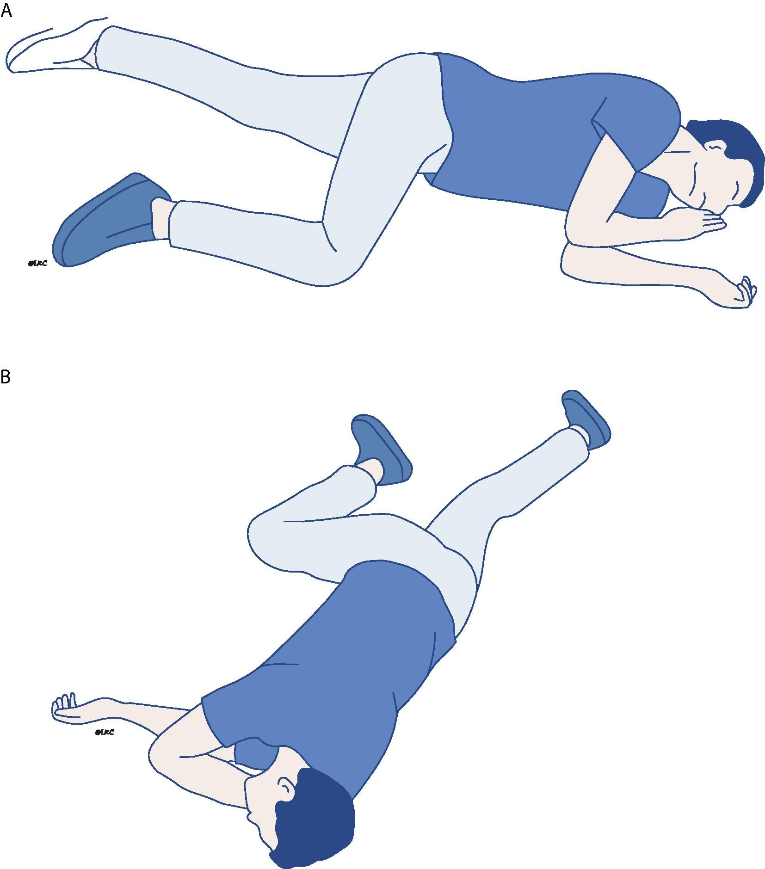

Slide 6
RECOVERY POSITION
Reassess for normal breathing every minute
If breathing normally
  Keep in the same position
  Check every minute
If not breathing normally
  Roll onto back
  Start basic life support

Slide 7
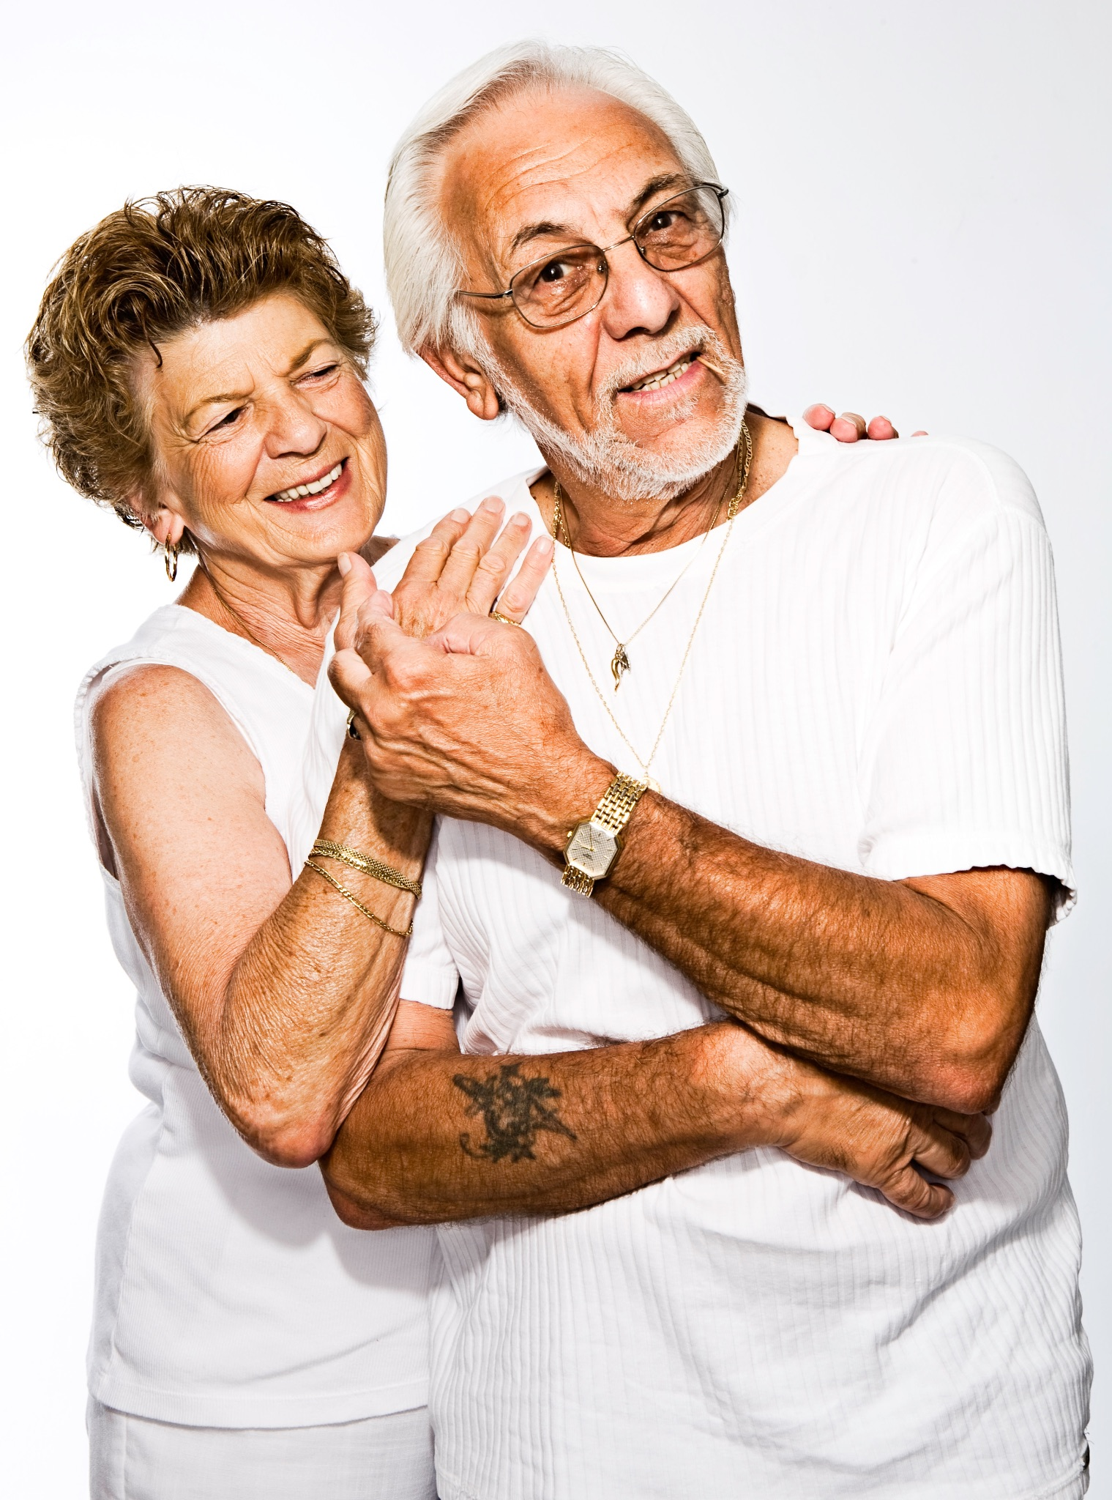

PRECAUTIONS WITH INFECTIONS
Most people who do BLS [in the community] do it on someone they know
The risk of transmission of disease causing serious harm to a rescuer is low
Blood or vomit may increase the risk & also makes rescue breaths less appealing to many people

Slide 8
GENERAL RISK ASSESSMENT
Individualised risk assessment
Am I willing to perform BLS on this person?
  Many rescuers know the person they are trying to resuscitate
  Personal consideration of moral injury
Notes:
Moral injury is defined as the profound psychological distress which results from actions, or the lack of them, which violate one's moral or ethical code. Morally injurious events can include acts of perpetration, acts of omission or experiences of betrayal from leaders or trusted others

Slide 9
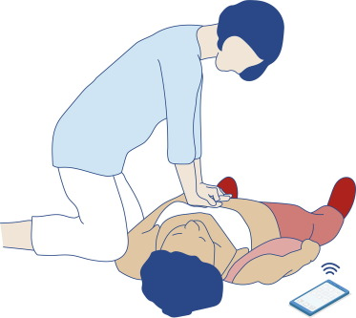
Compression only CPR if you do not give rescue breaths

Slide 10
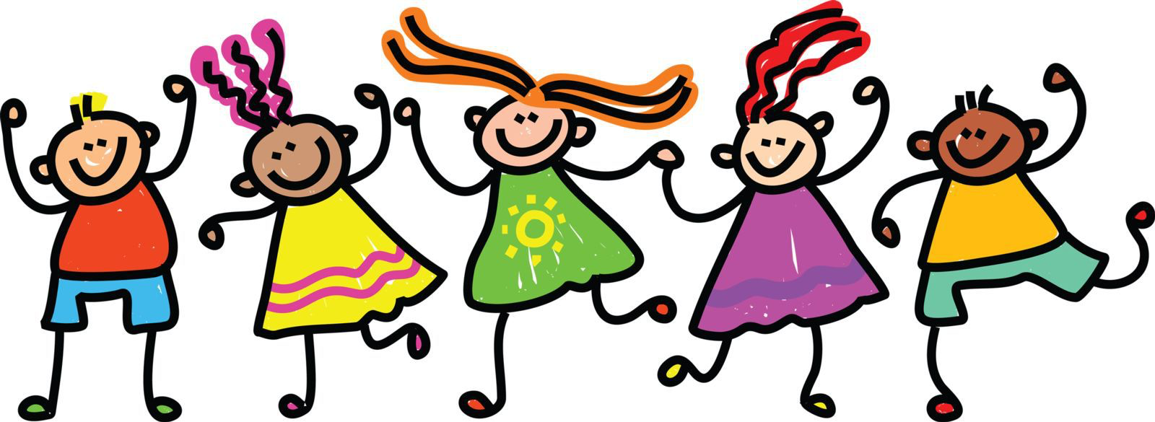
CHILDREN
Cardiac arrest is rare
Notes:
Cardiac arrest is rare
Almost always due to another major problem eg respiratory failure
Unresponsive & not breathing normally?
Adult CPR sequence can be used safely

Slide 11
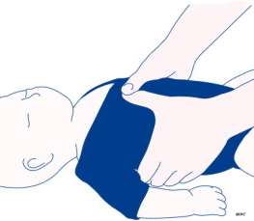
CHILDREN
Modifications to improve the sequence
  5 initial rescue breaths before CPR
  BLS for 1 minute before 999 call
Compress 1/3 depth of the chest
  Infants: 2 fingers
  Small child: 1 hand
  Large child: 2 hands
Notes:
This is an AGP risk: if you are willing to do them.
Rescue breaths in babies is quite challenging.

Slide 12
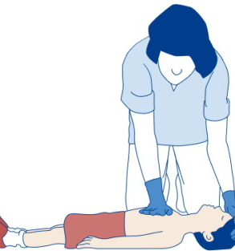
CHILDREN
Modifications to improve the sequence
  5 initial rescue breaths before CPR
  BLS for 1 minute before 999 call
Compress 1/3 depth of the chest
  Infants: 2 fingers
  Small child: 1 hand
  Large child: 2 hands

Slide 13
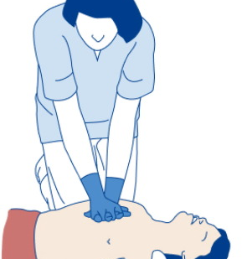
CHILDREN
Modifications to improve the sequence
  5 initial rescue breaths before CPR
  BLS for 1 minute before 999 call
Compress 1/3 depth of the chest
  Infants: 2 fingers
  Small child: 1 hand
  Large child: 2 hands

Slide 14
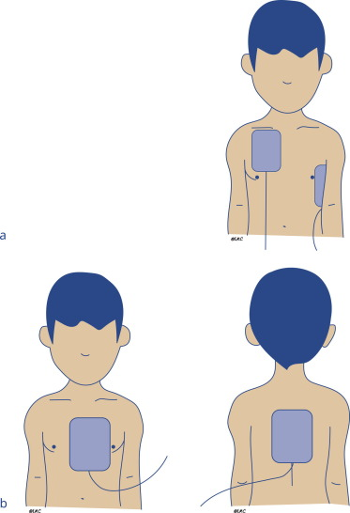
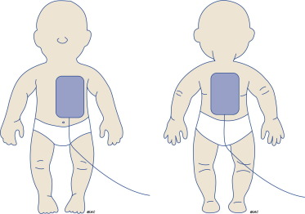
CHILDREN
Notes:
Automated external defibrillator use
Large child (≥8 yrs): Standard AED
Small child (1-8 yrs): Paed pads / standard
Infant (<1 yr): Manufacturer’s advice

Slide 15

DROWNING
Modifications to improve the standard sequence
  5 initial rescue breaths before CPR
  BLS for 1 minute before 999 call
Notes:
This is an AGP risk: if you are willing to do them then do so

Slide 16
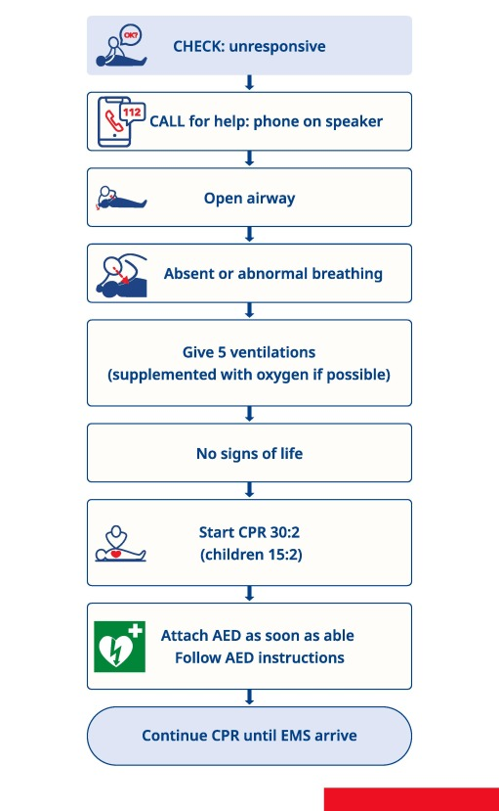
DROWNING
Modifications to improve the standard sequence
  5 initial rescue breaths before CPR
  BLS for 1 minute before 999 call
Notes:
This is an AGP risk: if you are willing to do them then do so

Slide 17
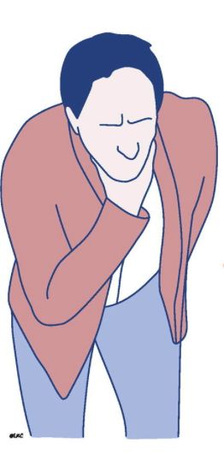
CHOKING
Most choking events associated with eating
Notes:
Potentially treatable cause of preventable death
Foreign body airway obstruction
Most choking events associated with eating
Witnessed
Holding throat, trying to cough, breathing problems

Slide 18
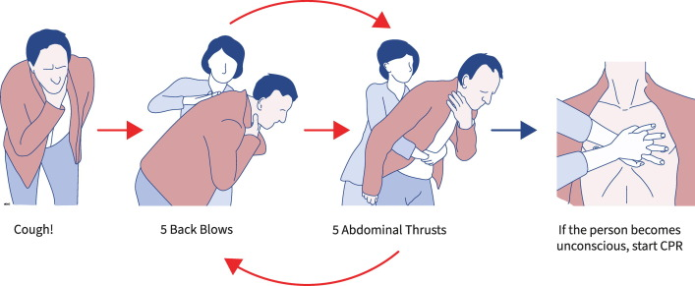
CHOKING
Suspect and recognise possibility of choking
Encourage to cough
Notes:
Keep your face away from the patient airway / face so that they don’t splutter over you; encourage them from a reasonable social distance (you could stand behind them)

Slide 19
CHOKING
Suspect and recognise possibility of choking
Encourage to cough
Can speak, cough and breathe
  Mild airway obstruction

Slide 20
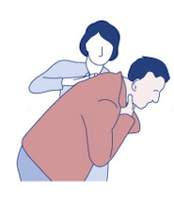
CHOKING
Severe airway obstruction & conscious
  5 back blows

Slide 21
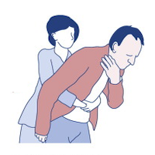
CHOKING
Severe airway obstruction & conscious
  5 back blows
  5 abdominal thrusts

Slide 22
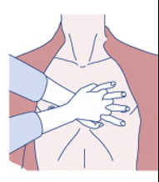
CHOKING
Person becomes unconscious
  Support them to the ground
  999
  Chest compressions
Notes:
chest compressions only; no rescue breaths (with the same caveats as your approach to AGPs). Recommend that default position for an unknown person is to follow national guidance & not expose yourself to risk

Slide 23
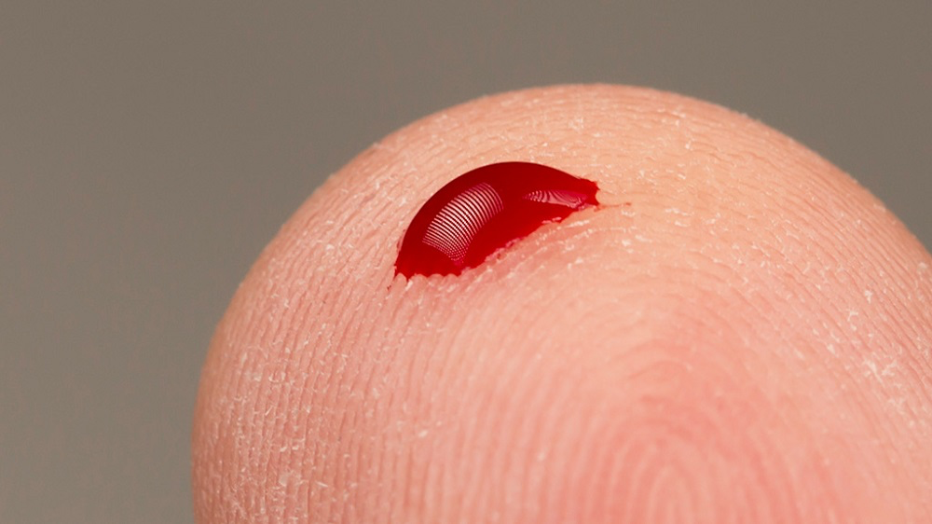
BLEEDING
Most bleeding is minor
  Wash the wound
  Apply direct pressure
  Localised cold therapy may be helpful
Notes:
Most treatment can be done by the patient and you can remain social distanced providing advice

Slide 24
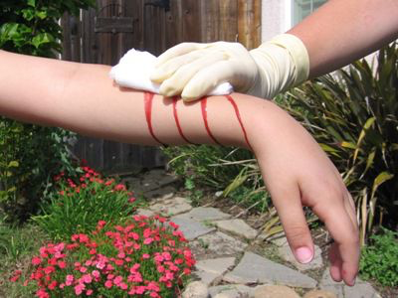
BLEEDING
Some bleeding is more serious
  Apply direct pressure ± dressing
Notes:
Even with more severe bleeding; consider patient contacts who could provide treatment with your advice and so prevent you getting close

Slide 25
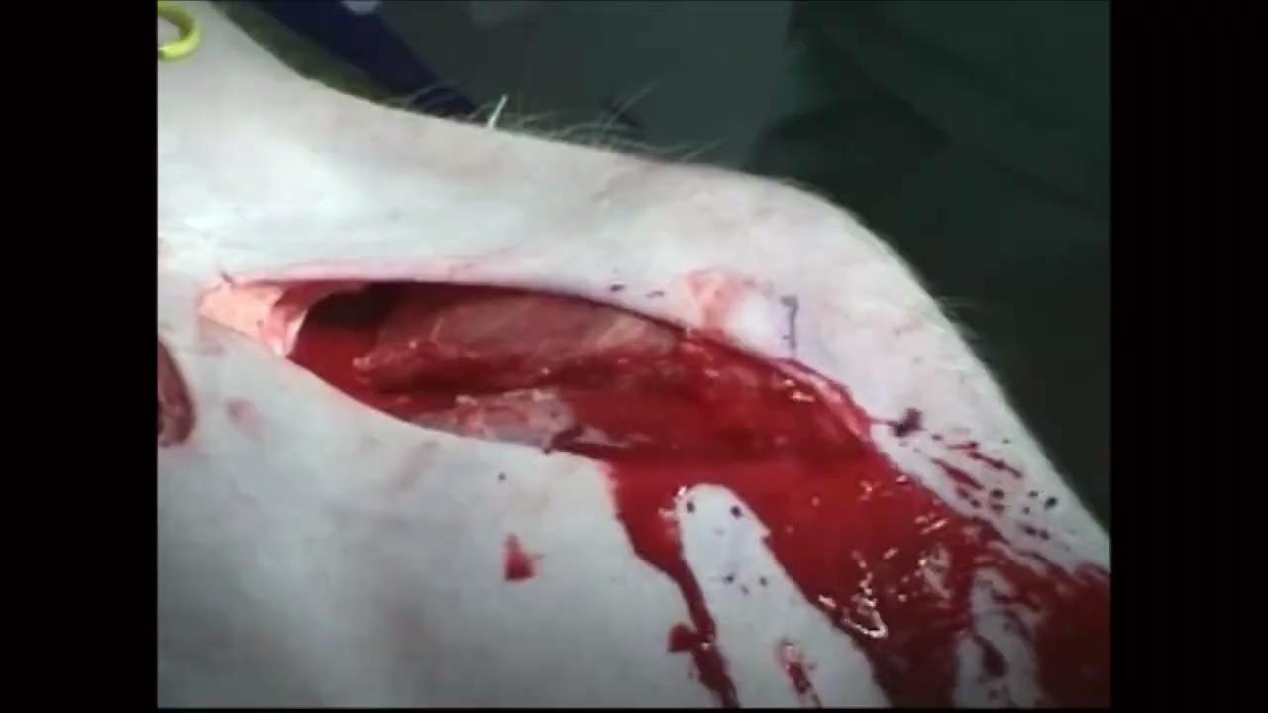
BLEEDING
Some bleeding is catastrophic
  Treat it first
  Apply direct pressure ± dressing

Slide 26
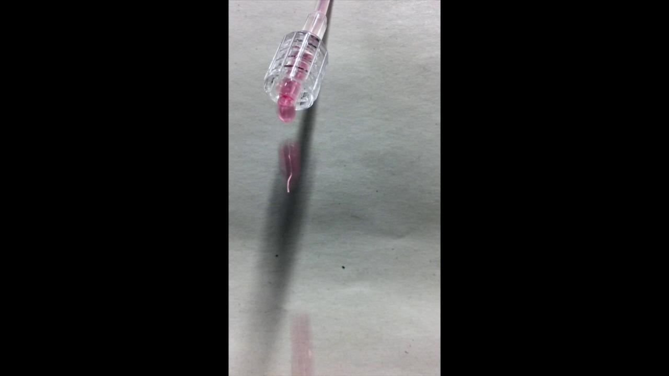
Notes:
2L/hr

Slide 27
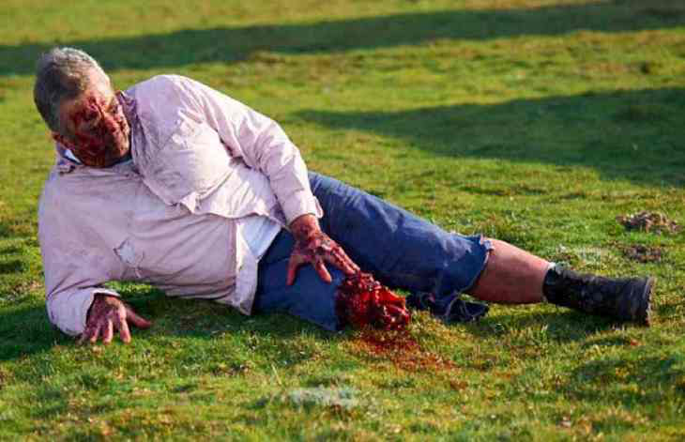
BLEEDING
Some bleeding is catastrophic
  Apply direct pressure ± dressing
  Tourniquet
Notes:
This is an amputee actor in trauma team training…

Slide 28
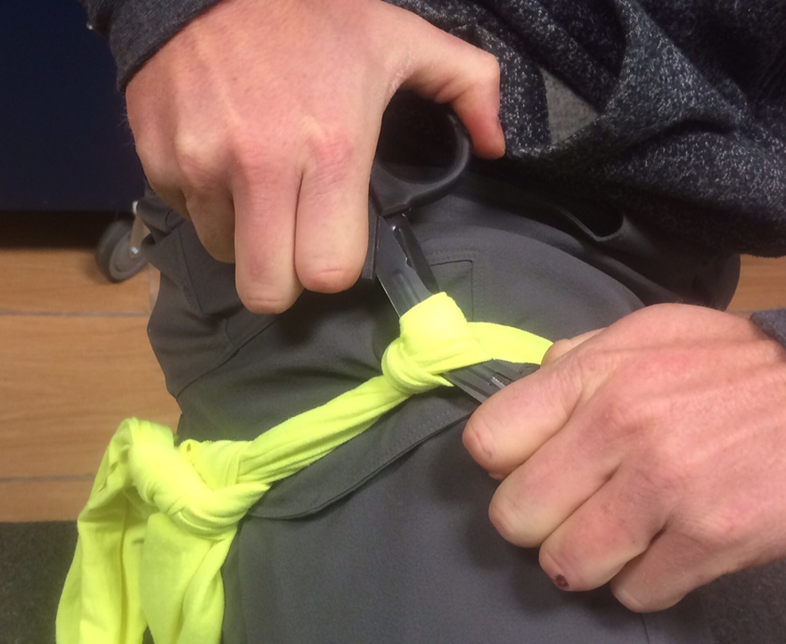
BLEEDING
Some bleeding is catastrophic
  Stay safe
  Act fast & take control
  Apply direct pressure ± dressing
  Tourniquet

Slide 29
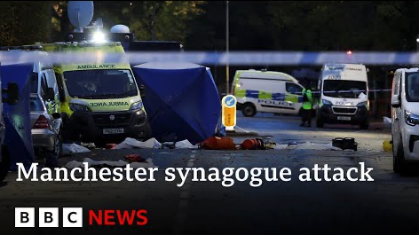
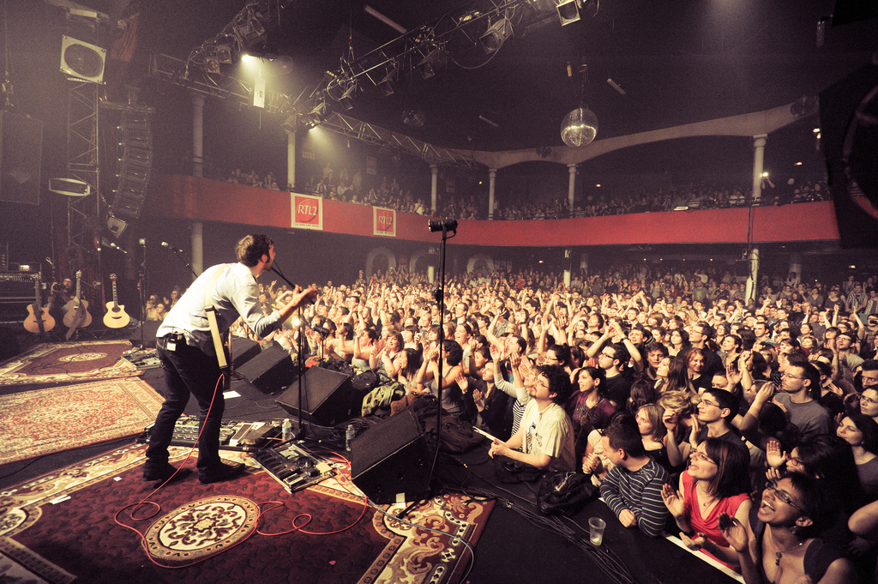

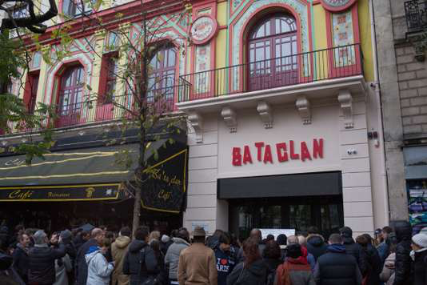

Notes:
This is the Bataclan (Paris terrorist attacks) - 2015 & Manchester (2017 & 2025)
In the Bataclan, the emergency responders ran out of tourniquets and needed to use makeshift ones due to the number of injuries (ie amputations)
Why worry about catastrophic bleeding?
Think about where you are… Birmingham is safe but is a clear terrorist target & as a big city, also has a high prevalence of knife crime

Slide 30
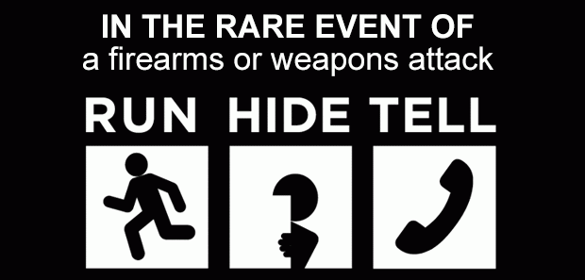
Notes:
This is the UK advice in the event of getting caught up in a terrorist incident

Slide 31
ANY QUESTIONS?

Slide 32
SUMMARY
Standard basic life support & automated external defibrillator algorithm
  If in doubt, use this
Minor modifications make it better in some circumstances
  Paediatric resuscitation: 5 breaths, 1 minute before 999, ⅓ depth of chest
  Drowning: 5 breaths, 1 minute before 999
Severe airway obstruction due to choking needs immediate treatment
  Back slaps, abdominal thrusts, CPR
Serious bleeding may need to be the first problem you treat
  Direct pressure ± dressing, tourniquet

Slide 33
SUMMARY
Standard basic life support & automated external defibrillator algorithm
  If in doubt, use this
Minor modifications make it better in some circumstances
  Paediatric resuscitation: 5 breaths, 1 minute before 999, ⅓ depth of chest
  Drowning: 5 breaths, 1 minute before 999
Severe airway obstruction due to choking needs immediate treatment
  Back slaps, abdominal thrusts, CPR
Serious bleeding may need to be the first problem you treat
  Direct pressure ± dressing, tourniquet

Slide 34
SUMMARY
Standard basic life support & automated external defibrillator algorithm
  If in doubt, use this
Minor modifications make it better in some circumstances
  Paediatric resuscitation: 5 breaths, 1 minute before 999, ⅓ depth of chest
  Drowning: 5 breaths, 1 minute before 999
Severe airway obstruction due to choking needs immediate treatment
  Back slaps, abdominal thrusts, CPR
Serious bleeding may need to be the first problem you treat
  Direct pressure ± dressing, tourniquet

Slide 35
SUMMARY
Standard basic life support & automated external defibrillator algorithm
  If in doubt, use this
Minor modifications make it better in some circumstances
  Paediatric resuscitation: 5 breaths, 1 minute before 999, ⅓ depth of chest
  Drowning: 5 breaths, 1 minute before 999
Severe airway obstruction due to choking needs immediate treatment
  Back slaps, abdominal thrusts, CPR
Serious bleeding may need to be the first problem you treat
  Direct pressure ± dressing, tourniquet

