Slide 1


Slide 2
Basic Life Support Instructor Course

Slide 4


Slide 5
SATURDAY MORNING | SATURDAY AFTERNOON | SUNDAY
BLS / AED Provider course | BLS / AED Instructor course | BLS / AED Instructor course

Slide 6
SATURDAY MORNING | SATURDAY AFTERNOON | SUNDAY
BLS / AED Provider course | BLS / AED Instructor course | BLS / AED Instructor course

Slide 7
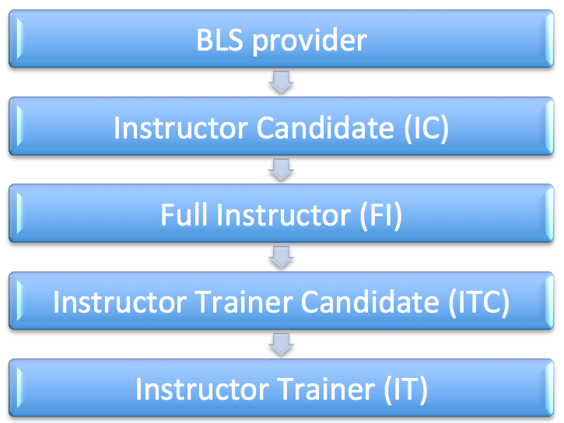

Slide 8
YOU ARE
ESSENTIAL

Slide 9
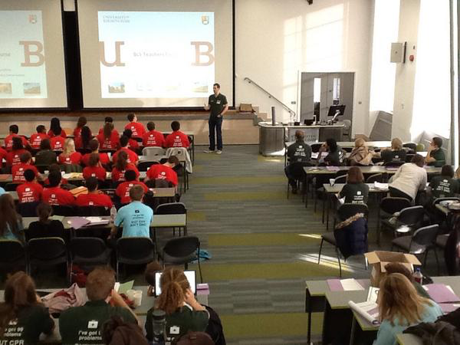

Slide 10
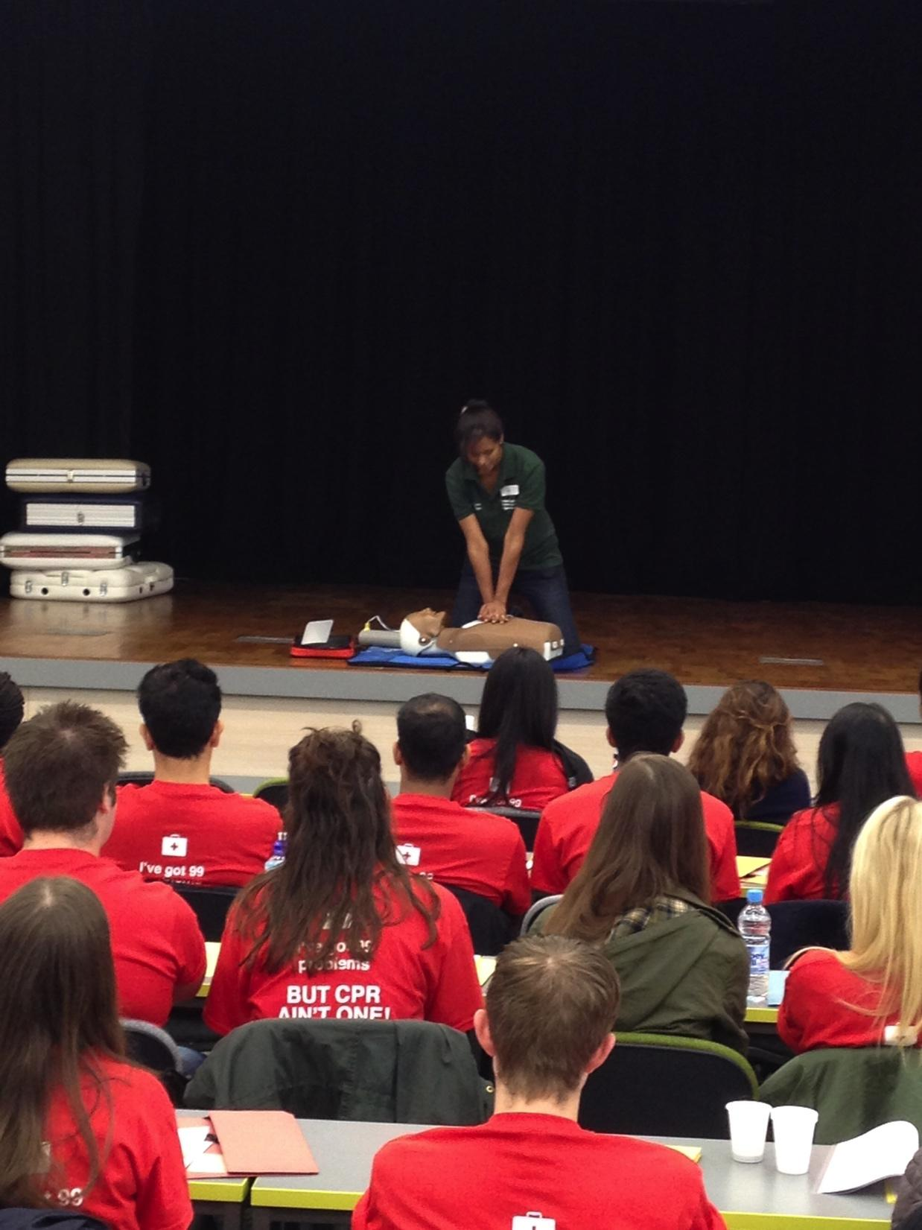

Slide 11
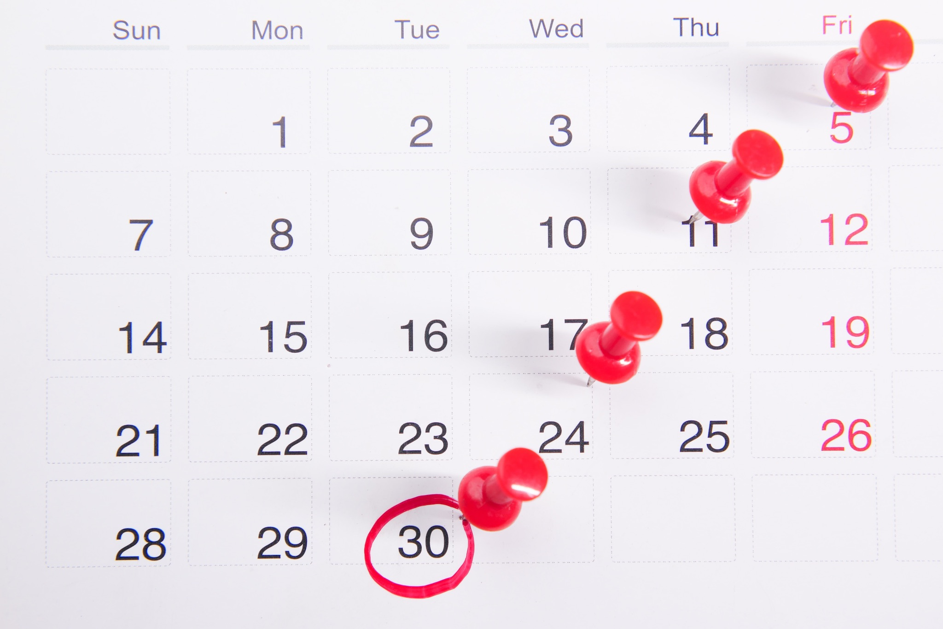
Notes:
You will then teach throughout the year on all of the courses

Slide 12
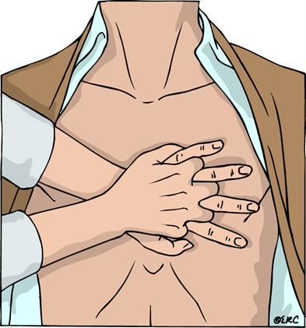
Notes:
basic life support

Slide 13

Notes:
first aid

Slide 14
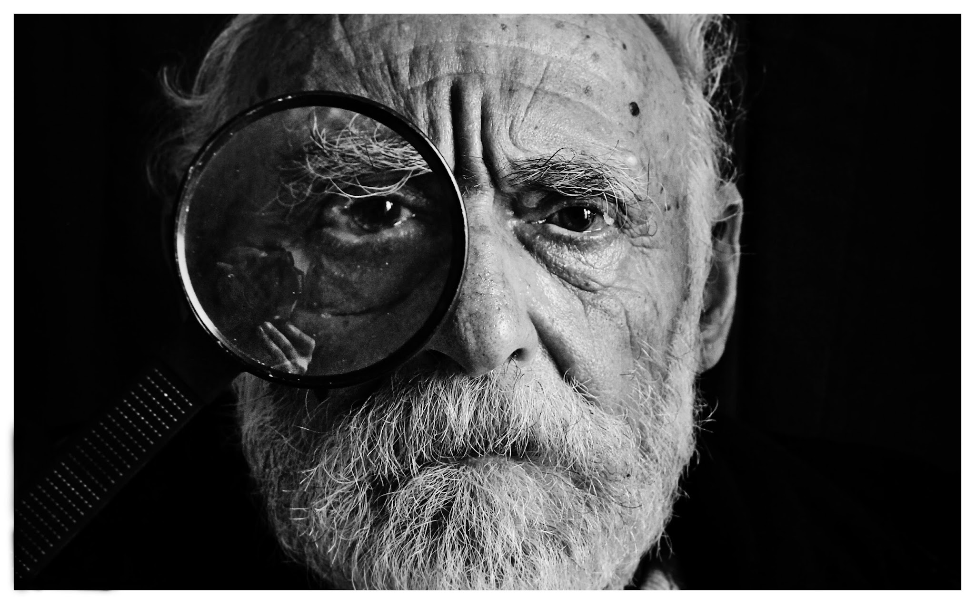
Notes:
assessment

Slide 15

Notes:
will now tell you how it all fits together

Slide 16
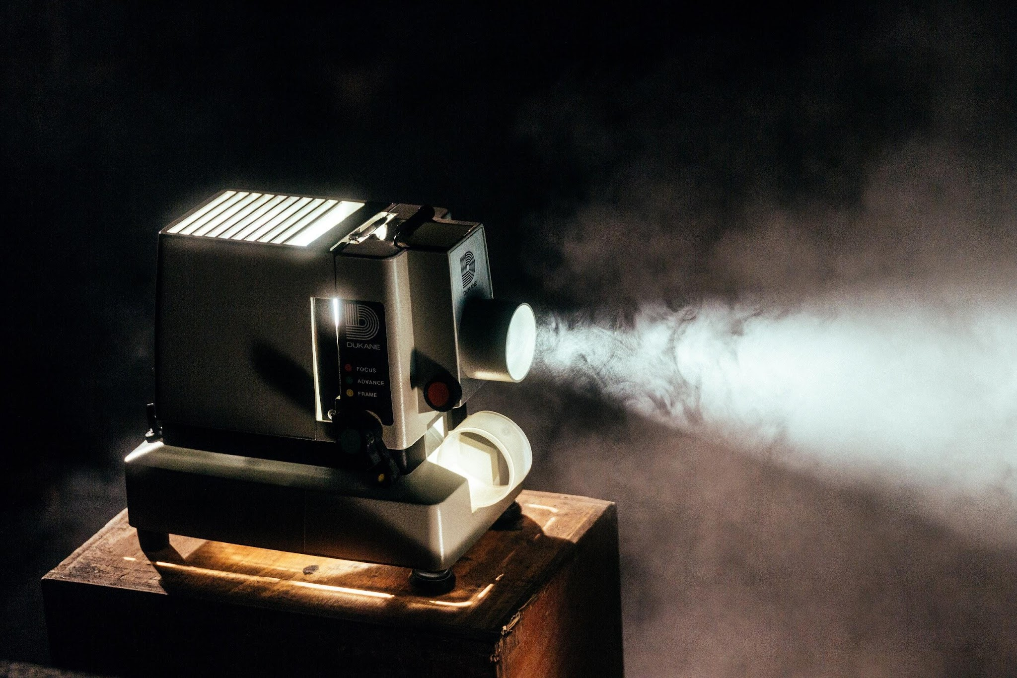

Notes:
some plenary lectures - and some may be streamed within your rooms as part of teaching

Slide 17

Notes:
small group learning: lots of practicals

Slide 18
Notes:
Since 1995: what is it?

Slide 19

INTERNATIONAL REPUTATION
Recognised as a centre of excellence in peer led basic life support tuition

Slide 20

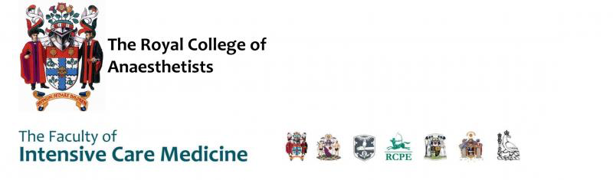

Slide 21
ACTIVE RESEARCH GROUP
Multiple submissions to peer reviewed journals and international meetings

Slide 22
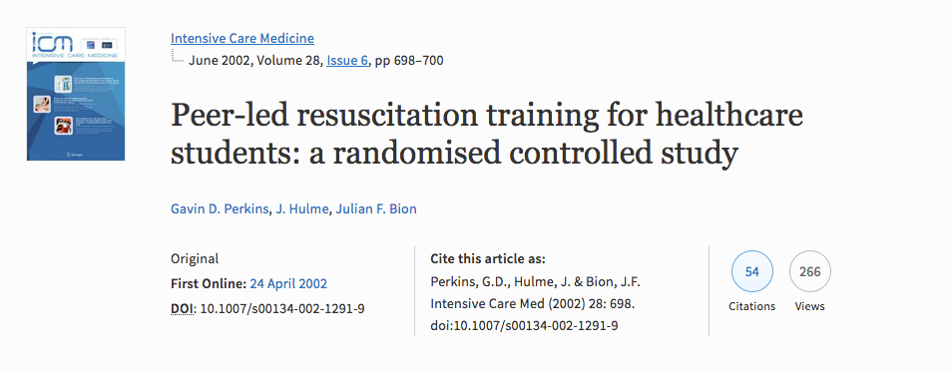

Slide 23


Slide 24
IN 2017, 2018 and 2022
Formation of a second, third and fourth RMD groups

Slide 25
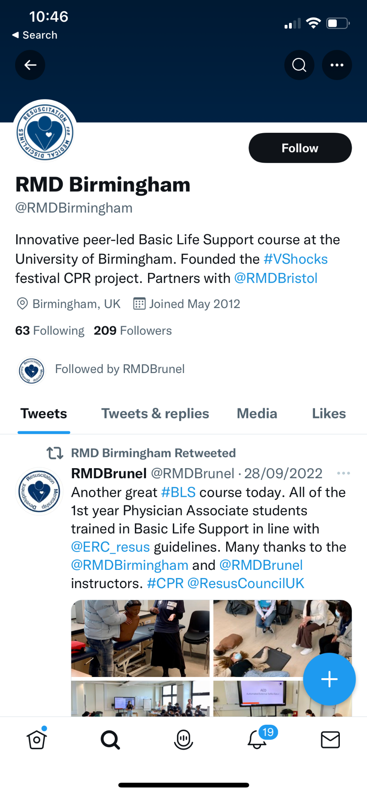
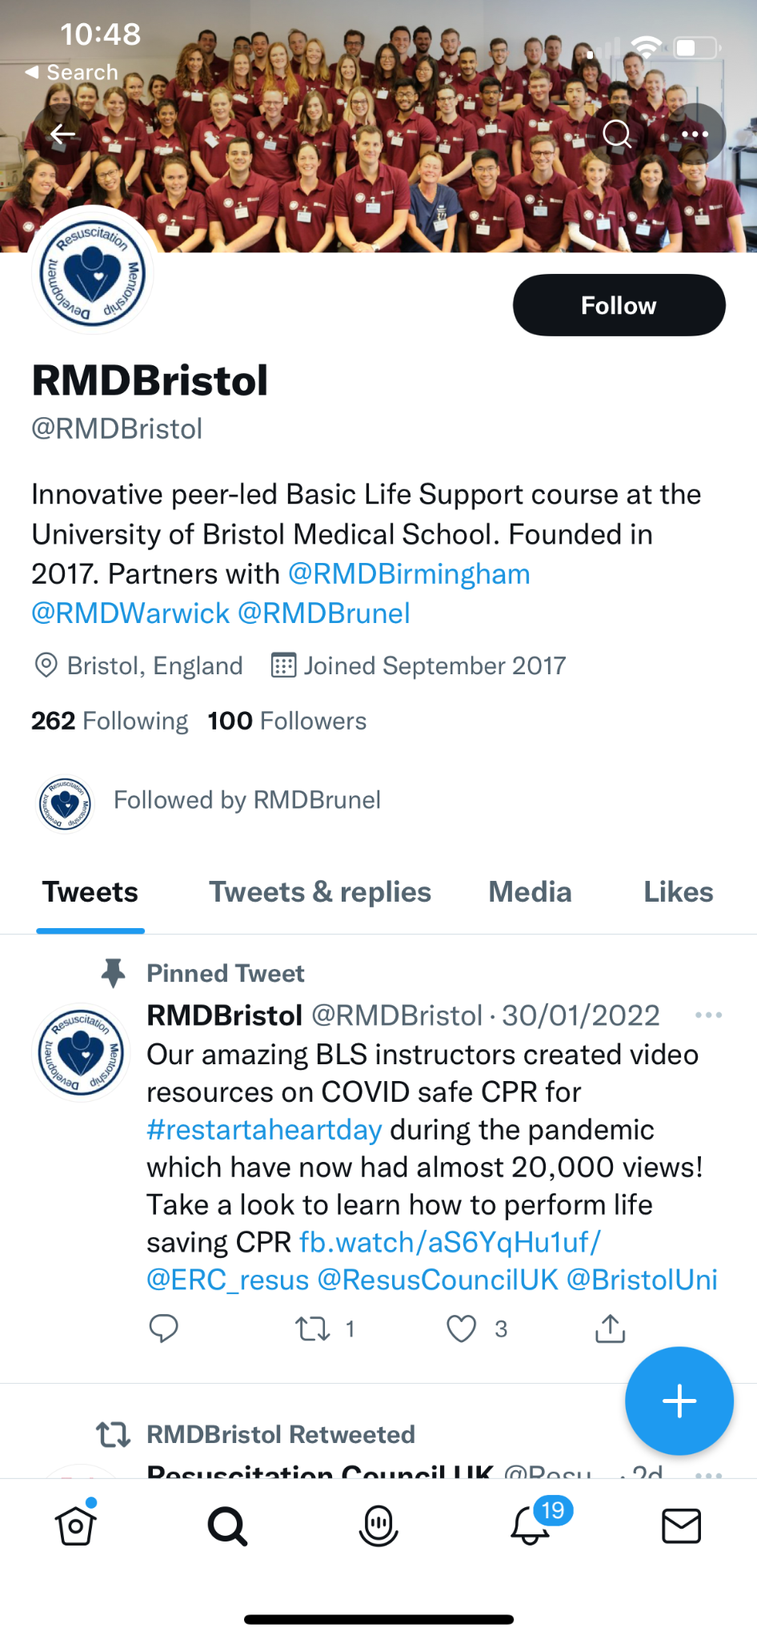
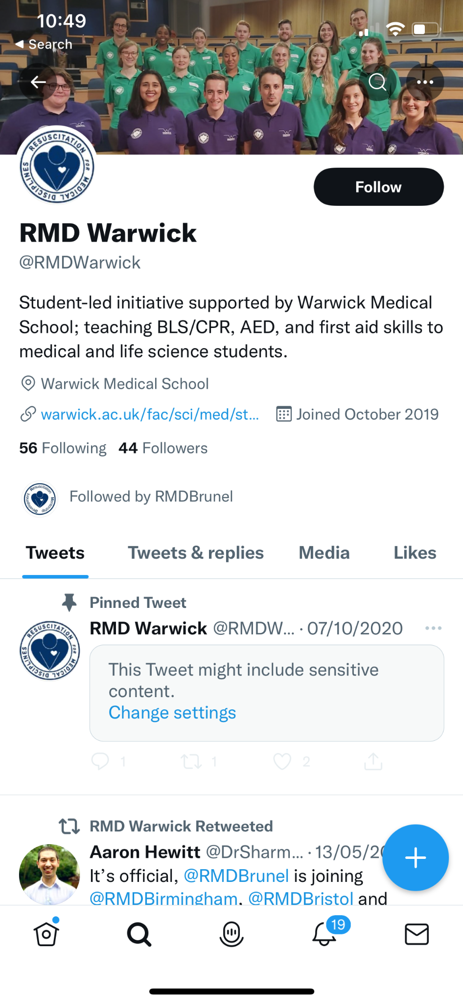
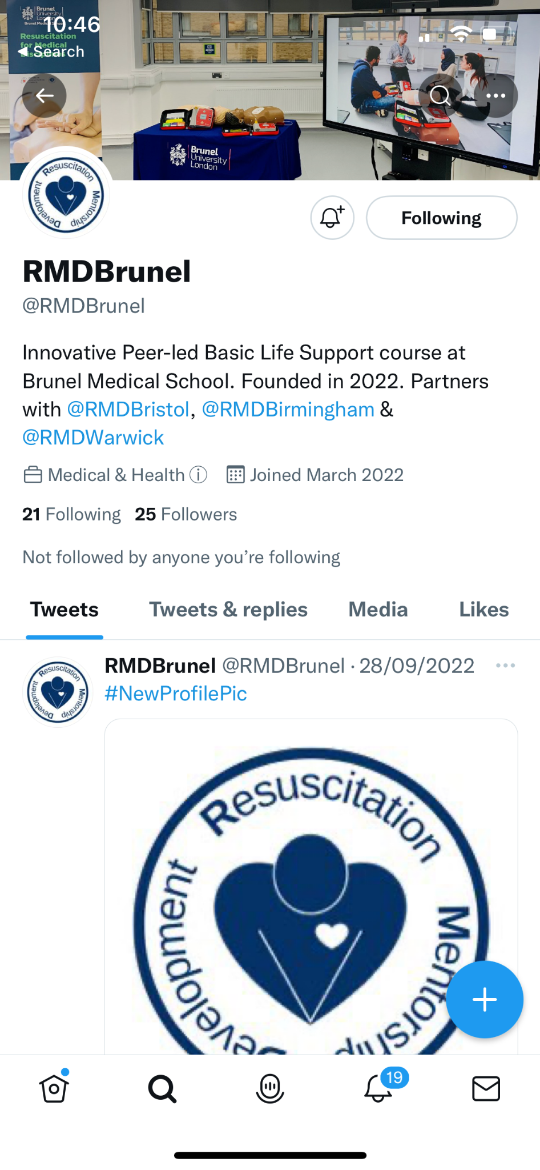

Slide 26


Slide 27
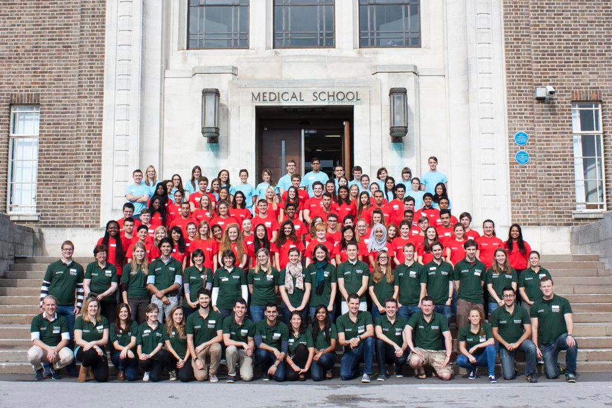

Slide 28


Slide 29
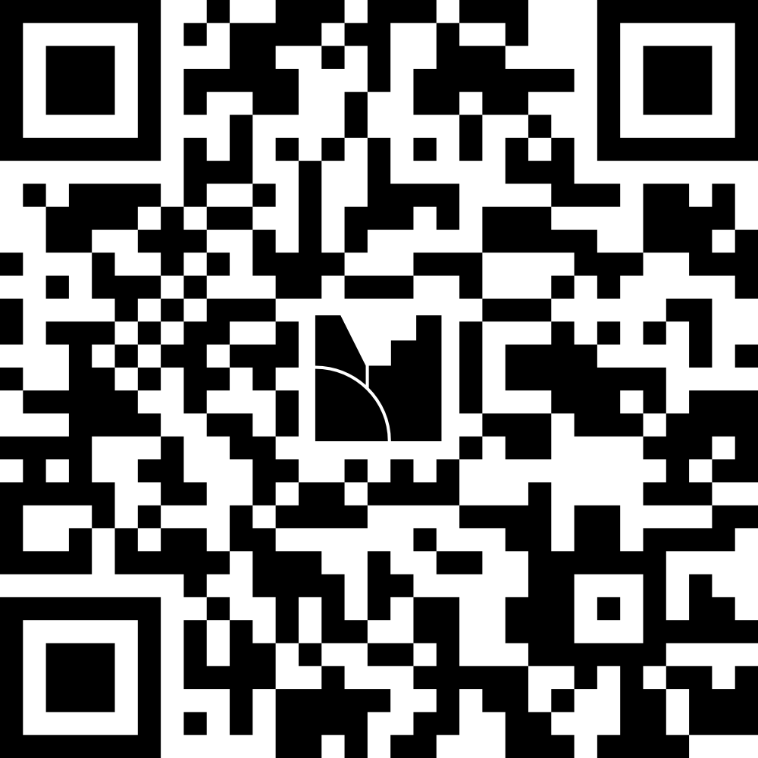

Slide 30
The Faculty

Slide 31
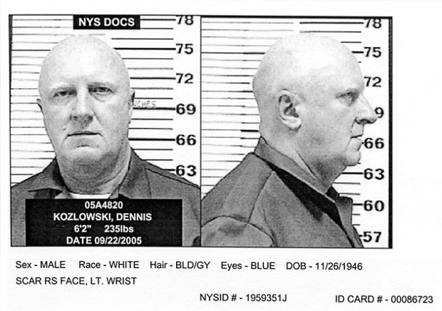
THE FACULTY
Notes:
This week we are focusing on how to safely operate an AED (automated external defibrillator)
Last week you learnt about early recognition, call for help and CPR for a cardiac arrest.
This week we’re focusing on early on defibrillation - which aims to shock the heart back into a normal sinus rhythm.

Slide 32
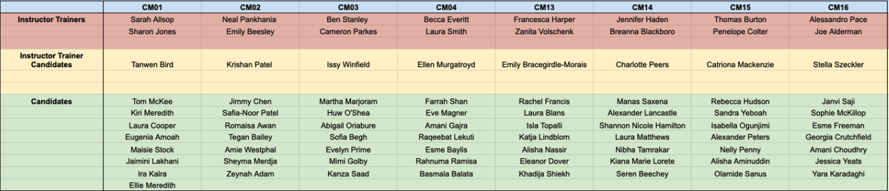

Slide 33
ANY QUESTIONS?

Slide 34
RMD 2025/26
Welcome to the team..!

